Slide 1
Weekly Finance Dashboard Automation
From Manual Excel to Orchestrated Snowflake + Tableau
From Manual Excel to Orchestrated Snowflake + Tableau
Tanya Kray Data Analytics Team
02/17/2026

Slide 2
Why We Automated
Business-critical weekly reporting
Manual Excel-based process
2–4 hours of effort each week
Embedded KPI logic
High dependency on manual updates

Slide 3
Before: Manual Excel-Based Weekly Reporting
Current Excel Dashboard - Caseload
• Manual data extracts from multiple source systems
• Weekly rolling date logic updated manually
• KPI calculations embedded in Excel formulas
• No centralized version control or audit trail
Person-dependent, manual reporting process

Slide 4
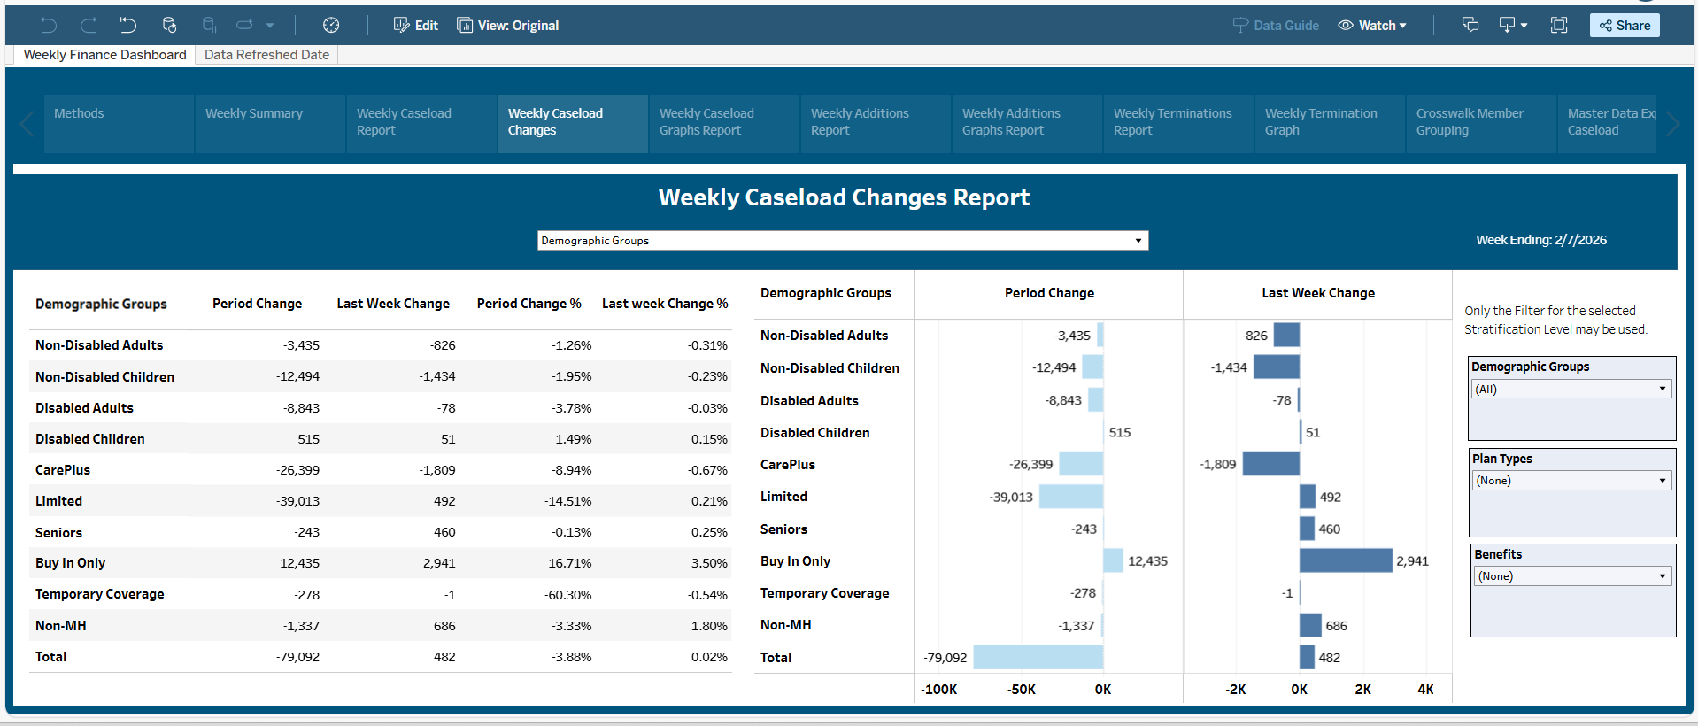
After: Automated Snowflake + Tableau Workflow
• Data generated by Snowflake stored procedures • Business-week logic calculated dynamically (Fri–Thu) • KPI logic centralized in SQL (not Excel formulas) • Task scheduled via CRON (6 AM UTC) • Tableau extract refresh triggered after ETL • Automated 9:00 AM subscription delivery
“Total MH calculated in Snowflake (no Tableau logic required)”
“Adds and Terms calculated separately for transparency”
“All reporting tables pre-aggregated for Tableau consumption”

Slide 5
Execution Flow & Dependency Control
Snowflake Task
Master Procedure
Modular Stored Procedures (10+)
Success / Failure Email
Tableau Extract Refresh
9:00 AM Subscription Delivery
• Single execution entry point • Step-level logging via RESULT_SCAN • Fail-fast behavior (RAISE) • Tableau refresh triggered only after ETL completion

Slide 6
Previous Process – Manual Workflow
Export Data
Update Excel File
Adjust Rolling Dates
Recalculate KPIs
Validate Results
Email Report
Manual intervention is required at every step

Slide 7
Business Logic Overview
Weekly Snapshot
Based on most recent Saturday
Includes active members only
Uses eligibility effective/end date logic
Caseload
Calculated across:
Demographic
Plan Type
Benefits
Reporting Structure
Outputs standardized into reporting tables
Categories aligned using crosswalk tables

Slide 8
Task Scheduling + Dynamic Date Logic
Task:
CREATE OR REPLACE TASK MHTEAM.MHA.BUDGET_WEEKLY_SP WAREHOUSE = MHA_WH SCHEDULE = 'USING CRON 0 6 * * 4 UTC'AS CALL MHTEAM.MHA.BUDGET_WEEKLY_MASTER_SP();
Dynamic Date Logic (Business Week: Fri–Thu)
SET week_end_date = DATEADD( day, -MOD(DATE_PART('DOW', CURRENT_DATE()) - 4 + 7, 7), CURRENT_DATE() );SET week_start_date = DATEADD(day, -6, :week_end_date);
• Runs weekly via CRON • Uses dedicated warehouse • Calls single orchestration entry point
Example run date: 2026-02-13 (Fri) Window: 2026-02-06 → 2026-02-12

Slide 9
Master Procedure – Orchestration + Notifications (Part 1)
CREATE OR REPLACE PROCEDURE MHTEAM.MHA.BUDGET_WEEKLY_MASTER_SP()
RETURNS VARCHAR
LANGUAGE SQL
EXECUTE AS OWNER
AS
$$
DECLARE
out_msg STRING DEFAULT '';
one_msg STRING;
BEGIN
/* MAIN PIPELINE */
CALL MHTEAM.MHA.BUDGET_WEEKLY_SNAPSHOT_L();
SELECT $1 INTO :one_msg FROM TABLE(RESULT_SCAN(LAST_QUERY_ID())); out_msg := out_msg || one_msg || '\n';
CALL MHTEAM.MHA.BUDGET_WEEKLY_CASELOAD_DEMOGRAPHIC_L();
SELECT $1 INTO :one_msg FROM TABLE(RESULT_SCAN(LAST_QUERY_ID())); out_msg := out_msg || one_msg || '\n';
CALL MHTEAM.MHA.BUDGET_WEEKLY_CASELOAD_PLANTYPE_L();
SELECT $1 INTO :one_msg FROM TABLE(RESULT_SCAN(LAST_QUERY_ID())); out_msg := out_msg || one_msg || '\n';
CALL MHTEAM.MHA.BUDGET_WEEKLY_CASELOAD_BENEFIT_L();
SELECT $1 INTO :one_msg FROM TABLE(RESULT_SCAN(LAST_QUERY_ID())); out_msg := out_msg || one_msg || '\n';
CALL MHTEAM.MHA.BUDGET_WEEKLY_ADDS_DEMOGRAPHIC_L();
SELECT $1 INTO :one_msg FROM TABLE(RESULT_SCAN(LAST_QUERY_ID())); out_msg := out_msg || one_msg || '\n';
CALL MHTEAM.MHA.BUDGET_WEEKLY_ADDS_PLANTYPE_L();
SELECT $1 INTO :one_msg FROM TABLE(RESULT_SCAN(LAST_QUERY_ID())); out_msg := out_msg || one_msg || '\n';
CALL MHTEAM.MHA.BUDGET_WEEKLY_ADDS_BENEFITS_L();
SELECT $1 INTO :one_msg FROM TABLE(RESULT_SCAN(LAST_QUERY_ID())); out_msg := out_msg || one_msg || '\n';
• Modular orchestration (10+ child procedures)
• Single execution entry point
• Step-level logging via
RESULT_SCAN()
• Automated success & failure notifications
• Fail-fast exception handling (RAISE;)

Slide 10
Master Procedure – Orchestration + Notifications (Part 2)
CALL MHTEAM.MHA.BUDGET_WEEKLY_TERMS_ALL_L();
SELECT $1 INTO :one_msg FROM TABLE(RESULT_SCAN(LAST_QUERY_ID())); out_msg := out_msg || one_msg || '\n';
CALL MHTEAM.MHA.BUDGET_WEEKLY_REFRESH_CHANGES2_L();
SELECT $1 INTO :one_msg FROM TABLE(RESULT_SCAN(LAST_QUERY_ID())); out_msg := out_msg || one_msg || '\n';
CALL MHTEAM.MHA.BUDGET_WEEKLY_REFRESH_CASELOAD_L();
SELECT $1 INTO :one_msg FROM TABLE(RESULT_SCAN(LAST_QUERY_ID())); out_msg := out_msg || one_msg || '\n';
/* SUCCESS NOTIFICATION */
CALL SYSTEM$SEND_EMAIL(
'MHA_EMAIL_INT',
'tatyana.kray@mass.gov',
'Weekly Budget Pipeline Completed',
out_msg
);
RETURN out_msg;
EXCEPTION
WHEN OTHER THEN
/* FAILURE NOTIFICATION */
CALL SYSTEM$SEND_EMAIL(
'MHA_EMAIL_INT',
'tatyana.kray@mass.gov',
'Weekly Budget Pipeline FAILED',
'Error:\n' || ERROR_MESSAGE()
);
RAISE;
END;
$$;
Key Design Patterns
• Success email includes full run log (out_msg)
• Failure email includes ERROR_MESSAGE()
• Fail-fast exception handling (RAISE;)
• Operational visibility without manual checking
*Note:
Recent Enhancements Included in Pipeline:
Total MH calculation applied during aggregation
Adds/Terms logic fully integrated into reporting layer
Consolidated reporting tables refreshed post-processing
/* Includes:
- Total MH logic
- Adds/Terms breakdown
- Consolidated table refresh
*/

Slide 11
Automation Controls & Governance
Upstream (Snowflake / ETL)
Master procedure orchestrates ETL logicScheduled via Snowflake Task (CRON)
Warehouse: MHA_WH
Success / failure email notifications
Manual override available if needed
Downstream (Tableau)
Extract scheduled after ETL completion
Subscription delivery at 9:00 AM ET
Failure alerts enabled
Clear ownership (BI / Data Engineering)

Slide 12
Reporting Data Model
Core reporting tables used by Tableau:
BG_CASELOAD
BG_ADDS_*
BG_TERMS_*
BG_CHANGES
Features:
Includes Total MH category
Pre-aggregated for Tableau performance
Standardized category ordering via crosswalk tables

Slide 13
Recent Enhancements to Weekly Finance Dashboard
Introduced Total MH (Total – Non-MH)
Eliminates manual subtraction in Tableau
Available across all reporting tabs
Enhanced Weekly Changes Logic
Net change now decomposed into:
Adds
Terms
Built Consolidated Reporting Tables
Standardized outputs for Tableau
Improved consistency across views
Implemented Rerun-Safe Logic (MERGE)
Prevents duplicate weekly loads
Enables safe reprocessing and backfills

Slide 14
Weekly Changes (Adds & Terms)
Adds → Members newly eligible compared to prior week
Terms → Members no longer eligible
Net Change → Adds – Terms
Logic calculated in Snowflake (not Tableau)
Ensures consistent results across all dashboard tabs

Slide 15
Impact + Reusable Automation Pattern
• ~2–4 hours saved weekly
• 100% elimination of manual date rolling
• 0 manual exports from source systems
• KPIs centralized in Snowflake (no Excel formulas)
• Reduced operational & audit risk
• Single orchestration entry point
• Modular stored procedure framework
• Dynamic business-week logic (no hardcoding)
• Built-in success / failure notifications
• Fail-fast execution model (RAISE)
• Easily extendable to new finance reports
From manual reporting → to controlled, auditable data engineering workflow

Slide 16
Reference links
Github repo: http://github.com/massgov-eohhs/mha_reg_reporting
Code for test cases
Reference text document (links to snowflake documentation imbedded)
Reference document: http://github.com/massgov-eohhs/mha_reg_reporting/blob/main/REF-automate-snowflake-task.md
Document compiled by automation workgroup with notes on steps to automate, example code, and links to snowflake documentation
Will be updated as testing / use continues
Cron syntax:
Snowflake cron: https://docs.snowflake.com/en/sql-reference/sql/create-task
General cron: https://crontab.guru/
Snowflake tasks documentation:
Tasks: https://docs.snowflake.com/en/sql-reference/sql/create-task
Procedures: https://docs.snowflake.com/en/sql-reference/sql/create-procedure

